Slide 1
Wopr Demo: Multi-ROUTING TDD

Slide 2
MR Prod readiness
“we adopted a Test-Driven Development (TDD) approach to guide design and ensure production-readiness.”

Slide 3
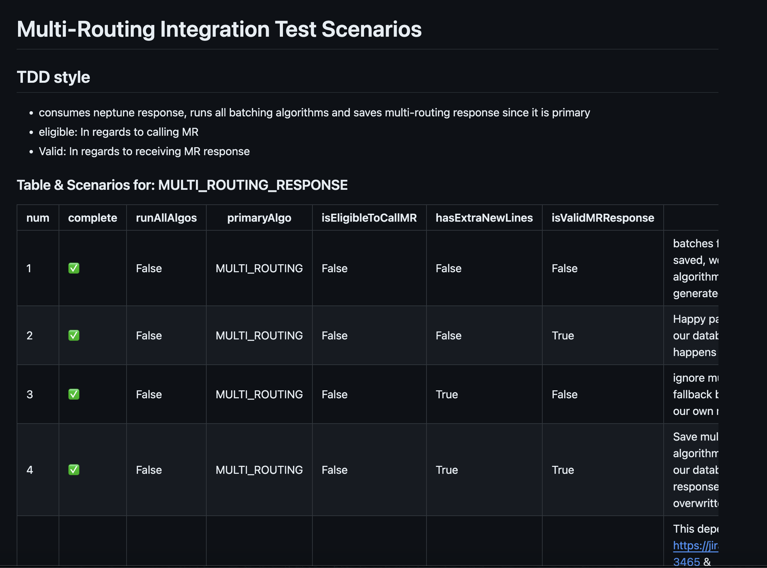
Multi_Routing_Scenario.md
built a suite of over 20 integration scenarios
Each case tests key dimensions:
Call eligibility
Valid responses
New lines

Slide 4
TDD Results
Helped catch edge cases early
Improved team alignment
Increased overall confidence

Slide 5
Questions

Slide 6
Thank you
Presenter: Abdul Ashwood
Slack: @wopr-team
Email: tt-wopr@target.com

